Slide 1
PRODUCT AND ARCHITECTURE REVIEW
Clinical Trial
Intelligence
PRODUCT THESIS
Help users move from an ordinary question to a verified set of trial records without turning the product into a medical decision maker.
Current product, system design, model controls and path to an agent enabled platform
Current status
Public demo. Live registry data. Technical validation completed. User and commercial validation remain open.
Independent capability build using live ClinicalTrials.gov data
29 October 2026
Prepared for product, clinical and technical review
Notes:
Project source reviewed at commit 2cbd9031251f08005d1bfb1d5df41b7a58014f41 on 29 October 2026.

Slide 2
Executive assessment
02
The product has a defensible technical core, but commercial proof still depends on a focused pilot
What holds up
What remains unproven
Strategic conclusion
Live registry retrieval with source links and explicit evidence for each match
No external user study has established task success or repeated use
The next investment should validate one workflow, not add more surface area.
Hybrid search combines lexical retrieval, embeddings and deterministic constraints
The product still serves several audiences without a confirmed primary persona
Unsafe plain language paraphrasing was removed after evaluation exposed semantic risk
Software tests and model evaluation do not prove clinical validity or willingness to pay
Recommended wedge
Medical Affairs trial education and outreach planning
The architecture limits stored health data and keeps AI outputs traceable to public sources
Several enterprise controls remain incomplete, including durable rate limiting and production monitoring
Decision required
Run a bounded pilot before funding persistent profiles or autonomous agents
Clinical Trial Intelligence
Assessment based on current source, roadmap and observed product state
Notes:
The assessment distinguishes technical evidence from user and commercial evidence. No market demand or clinical outcome claim is made.

Slide 3
Clinical trial information workflow
03
The registry contains the source data, while the decision workflow spans multiple tools and interpretation steps
01
02
03
04
05
Question
Registry search
Interpretation
External context
Next action
A patient or professional starts with a condition, location, treatment history or biomarker.
Search syntax and registry vocabulary determine which records appear.
Dense criteria, study design and site records require manual review.
Population, travel, education and outreach context sits elsewhere.
Users create a shortlist, spreadsheet, referral path or outreach plan.
Product opportunity
Compress search, interpretation and verification into one auditable workflow while preserving the registry as the source of truth.
Clinical Trial Intelligence
Problem statement remains a product hypothesis until external workflow research is completed
Notes:
Source: project README and product design decisions. The workflow describes current manual friction, not measured time savings.

Slide 4
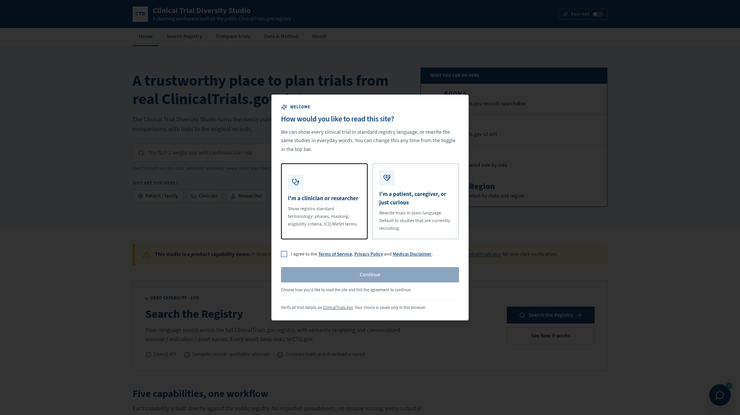
Current product workflow
04
The MVP supports discovery, verification and comparison while stopping short of clinical recommendation
1
Search
Natural language query across live ClinicalTrials.gov records
2
Verify
Match evidence, location checks and direct source links
3
Compare
Two to four trials, listed sites and selected Census context
4
Review documents
Temporary comparison of redacted files with published criteria
5
Export
Local comparison report with source attribution
Boundary: no eligibility decision, no trial recommendation, no autonomous outreach
Clinical Trial Intelligence
Current public build and source review, commit 2cbd9031
Notes:
The screenshot is from the same Lovable project. Current product capabilities were verified against the latest source commit. The screenshot predates the latest security and model changes but represents the current product surface.

Slide 5
Target users and decision jobs
05
One data foundation can support several audiences, but each requires a different product promise and validation standard
Audience
Decision job
Product output
Priority
Medical Affairs
Connect disease education and outreach programs with relevant recruiting trials
Trial shortlist, source verified rationale, education and referral path
Primary pilot
Clinical operations and feasibility
Find comparable studies and review sites, populations and published criteria
Comparable cohort, geography review, feasibility brief
Secondary
Patients and caregivers
Find and interpret trials using ordinary language
Understandable shortlist with direct source verification
Exploratory
Digital outreach and patient engagement
Route campaign audiences toward relevant trial information
Content to trial mapping with approved messaging
Future
Design implication
Keep the shared retrieval and evidence layer. Validate a dedicated workflow for Medical Affairs before expanding audience specific automation.
Clinical Trial Intelligence
Priority reflects the proposed commercial sequence, not confirmed demand
Notes:
Target users come from the product hypothesis and earlier portfolio discussion. The first proposed paid pilot is Medical Affairs. No external user group has validated the workflow yet.

Slide 6
Current system architecture
06
The production path separates user experience, orchestration, model tasks, public data and retained application data
CHANNELS
EXPERIENCE
ORCHESTRATION
AI AND RETRIEVAL
DATA AND SERVICES
Patient or
caregiver
React web app
Supabase Edge
Functions
Deterministic
intent parser
ClinicalTrials.gov
v2 API
Supabase Postgres
Audience mode
Search registry
Trial details
Compare trials
PDF report
Origin checks
Bot challenge
Rate limits
Request shaping
Source fetching
Response controls
ACS cache
Evaluation cases and runs
Issue reports
Admin access records
Legacy cohort tables retained but public routing retired
Medical
Affairs
BM25, embeddings,
RRF and constraint
reranking
US Census ACS
2022 five year
Clinical
team
Comparison assistant
Document to criteria
review
Lovable AI
Gateway
Cross cutting controls
No persistent patient profile
Temporary document processing
Source linked outputs
No store on search responses
Admin access separation
Evaluation logging
Clinical Trial Intelligence
Source: current project source and Supabase function design
Notes:
Architecture source paths include src, supabase/functions, drizzle schema and project roadmap at commit 2cbd9031. This slide describes the current deployed design, not a future target state.

Slide 7
Search and ranking architecture
07
Search uses deterministic interpretation, bounded live retrieval, hybrid ranking and evidence checks before presentation
1
User query
2
Intent parser
3
Adaptive retrieval
4
Candidate shaping
5
Lexical rank
Condition, location, status, phase, age, stage, treatment or biomarker
Rules extract supported concepts. No model call occurs at this stage.
Up to three ClinicalTrials.gov calls and 75 live candidates
Normalize registry fields, facilities, sponsor, indication and asset names
Lunr BM25 scores title, conditions, interventions and eligibility text
10
Top results
9
Evidence grounding
8
Constraint rerank
7
Rank fusion
6
Dense rank
Return up to 10 records with match reasons, warnings and source links
Confirm concepts against registry fields and facility locations
Subtype conflicts, query evidence and US preference adjust order
Reciprocal rank fusion combines lexical and dense rank order
Gemini Embedding 2 creates query and candidate vectors for cosine similarity
Validation gates
Input
Retrieval
Ranking
Output
Length, origin, bot and rate checks
Warnings disclose bounded candidate coverage
Scores stay hidden because the fused score lacks user meaning
Every record links back to ClinicalTrials.gov
Clinical Trial Intelligence
Source: ctg-search, queryIntent, hybridSearch and hybridRanking functions
Notes:
Current limits: PAGE_SIZE 25, MAX_CANDIDATES 75, MAX_CTG_CALLS 3. Ranking method: BM25, dense cosine, reciprocal rank fusion and constraint reranking. Embedding model: google/gemini-embedding-2.

Slide 8
Model and method inventory
08
Each model supports a bounded task. Deterministic logic and source verification carry the clinical constraints
Capability | Method or model | Role in the product | Control and current status
Query interpretation | Deterministic parser | Extract condition, location, status, phase, biomarker and prior treatment | No model call. Low confidence locations are disclosed.
Keyword retrieval | Lunr BM25 | Rank candidates using registry text | Runs only on live candidates returned by the registry.
Semantic retrieval | Google Gemini Embedding 2 | Create query and trial vectors for cosine similarity | Fused with BM25. It does not create clinical facts.
Comparison and guide | OpenAI GPT 6 Astra | Summarize selected records and answer questions using supplied trial and Census context | On demand. Source context only. No conversation persistence.
Document to criteria review | Google Gemini 2.5 Flash | Compare redacted documents with published eligibility criteria | Temporary file processing. Defaults to unclear. No eligibility decision.
Plain language trial view | Registry source view | Present exact registry wording and typed counts | Generated clinical paraphrasing was disabled after semantic failures.
Design rule: use models for ranking, summarization and evidence comparison. Keep registry facts, filters and safety boundaries deterministic.
Clinical Trial Intelligence
Model names and roles verified in current source at commit 2cbd9031
Notes:
Model references: hybridSearch uses google/gemini-embedding-2. comparison-ai uses openai/gpt-6-astra. ctg-eligibility-check uses google/gemini-2.5-flash. Plain language generation is disabled and marked registry-source-v1.

Slide 9
Validation system and evidence maturity
09
The strongest evidence covers system behavior and source fidelity. Usability and commercial evidence remain missing
Software behavior
120 automated tests
Regression coverage for access, ranking, grounding, reports, privacy and admin flows
1
AI evaluation
73 scored live runs
Five active AI features reviewed across grounding, constraints, safety and clarity
2
Source fidelity
Manual and live query checks
Returned records, locations and summaries cross checked against public source fields
3
Usability
No external study yet
No measured task completion, comprehension, time or repeated use
4
Commercial proof
No paid pilot yet
No validated buyer, procurement path or willingness to pay
5
Interpretation: current evidence supports a public capability demo. It does not support a clinical outcome, market demand or production accuracy claim.
Clinical Trial Intelligence
Source: project roadmap, evaluation framework and test suite
Notes:
The roadmap records 120 passing automated tests and 73 scored live evaluation runs. Historical and retest scores are separate and are not a current production accuracy estimate. No external users have validated the product.

Slide 10
Proposed Medical Affairs pilot
10
A focused pilot can test whether trial intelligence improves an existing education and outreach workflow
Pilot question
Can a Medical Affairs team connect disease education or patient outreach content to relevant recruiting trials faster and with better source traceability?
Pilot boundary
Decision support for professionals. No patient targeting, enrollment decision or autonomous messaging.
1
Content or campaign brief
2
Trial discovery
3
Professional review
4
Approved output
Condition, audience, geography and approved educational intent
Live search and evidence grounded shortlist
Medical and legal review of relevance and wording
Source linked trial education or referral pathway
Proposed decision criteria
Task completion
Traceability
Efficiency
Adoption
Users produce a verified trial shortlist for a real brief
Every material statement resolves to a source record
Time falls versus the current manual workflow
Users choose the workflow again for another brief
Clinical Trial Intelligence
Pilot design is proposed. No performance result is claimed
Notes:
The proposed pilot uses Medical Affairs as the first commercial wedge, based on the user's stated priority. All success measures are proposed decision criteria, not achieved metrics.

Slide 11
Future agent enabled architecture
11
Agents should coordinate bounded tools and evidence packets. Human approval remains mandatory for clinical and external actions
INTERACTION
CONTROL PLANE
SPECIALIST AGENTS
TOOLS AND DATA
MEMORY AND AUDIT
Discovery agent
Organization workspace
Medical Affairs
Clinical team
Patient or caregiver
Approved content systems
Coordinator agent
Query decomposition, live retrieval and evidence packet
ClinicalTrials.gov
Census and disease burden
Geospatial and travel services
Approved content repository
CRM or outreach workflow
Evaluation suite
Plans tasks, selects tools and assembles evidence
Approved cohorts
Evidence packets
Versioned prompts
Decision history
Criteria review agent
Document to criteria comparison with uncertainty
Policy and approval gate
Access agent
Travel, support and geographic context
Identity, consent, permitted tools, clinical review and action approval
Observability
Content linkage agent
Map approved education and outreach content to trials
Tool calls
Source lineage
Human approvals
Model and data drift
Evaluation agent
Regression checks, source drift and unsupported claim review
Non negotiable boundary: no autonomous eligibility decision, patient outreach, site ranking or clinical action without approved policy and human review.
Clinical Trial Intelligence
Target architecture. Future tools and agents require separate validation and governance
Notes:
This slide is a future target state. Geospatial services, content systems, CRM integration, persistent organization memory and specialist agents are not all present in the current public build.

Slide 12
Enterprise readiness gaps
12
The public demo can support discovery. An enterprise deployment requires stronger controls, evidence and operating ownership
Product
Primary persona and repeated workflow remain unvalidated
Run moderated workflow tests and one bounded Medical Affairs pilot
Clinical governance
No formal clinical review board or approved content workflow
Define review authority, escalation rules and prohibited outputs
Security and privacy
No persistent patient profile by design. Provider retention remains unverified
Complete privacy review, vendor terms, threat model and data retention controls
Reliability
In memory rate limits reset on cold start. Production service levels are undefined
Add durable rate limits, monitoring, incident response and service objectives
Model operations
Evaluation runs exist, but production drift and model change controls are incomplete
Version models and prompts, maintain regression sets, monitor source and output drift
Data coverage
Census enrichment depends on an API key and disease burden data is not integrated
Restore ACS access and validate additional population sources before scoring
Investment rule: close the buyer and governance gaps before adding persistent patient data or external actions.
Clinical Trial Intelligence
Gap assessment uses the current roadmap and source comments
Notes:
Current known gaps include in memory rate limits, existing lint debt, a Census API key dependency, no external user study and no paid pilot. The product intentionally avoids persistent patient profiles.

Slide 13
Implementation roadmap and decision gates
13
The sequence moves from user evidence to a governed pilot, then to agent orchestration only after the workflow proves value
0 to 8 weeks
2 to 4 months
4 to 9 months
Validate the core workflow
Run a Medical Affairs pilot
Build the governed platform
Recruit 5 to 8 participants across patients, caregivers and professionals
Use a real disease education or outreach brief
Add organization workspaces and audit history
Measure search, comparison and source verification tasks
Add approved content linkage and review workflow
Integrate geospatial and approved content systems
Create a labelled query and failure set
Measure time, correction rate and repeated use
Introduce specialist agents behind policy gates
Choose one primary persona
Document compliance and operating ownership
Establish model monitoring and service objectives
Gate: users complete the task and trust the source trail
Gate: the team repeats the workflow and funds continuation
Gate: enterprise controls support a broader rollout
Clinical Trial Intelligence
Roadmap is conditional. Each phase requires evidence before additional investment
Notes:
The timeline is a proposed implementation sequence. It does not represent committed delivery dates. The first validation target is 5 to 8 participants with a balanced mix of patients, caregivers and professionals.

